Slide 1
4.Make the data confess
Statistical Exploratory Analysis

Slide 2
We used a Poisson regression model to fit the training data to see if there is a linear relationship between "Involving Drink Driving" / "Involving Driver Speed" / "Involving Fatigued Driver" / "Involving Defective Vehicle" and the total number of crashes ("Count_Crashes"). We output the model summary and fitting results. If the red line is a straight line, it means that in this model, the relationship between the dependent variable (Crash Count) and the independent variable can be described by a linear function. This means that the impact of a one-unit increase in each independent variable on the dependent variable is constant, i.e., this relationship is linear.

Slide 3
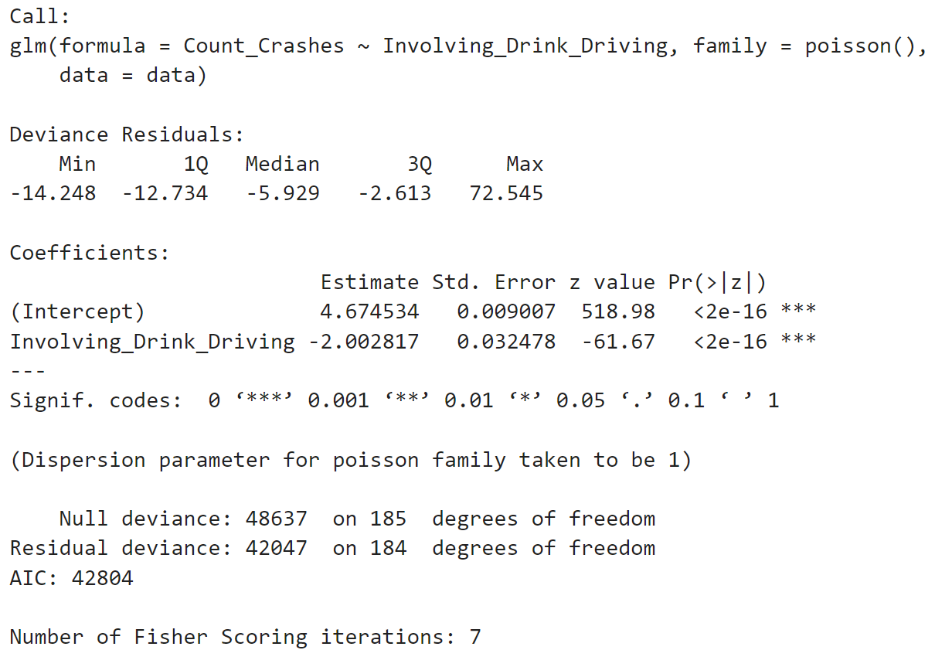
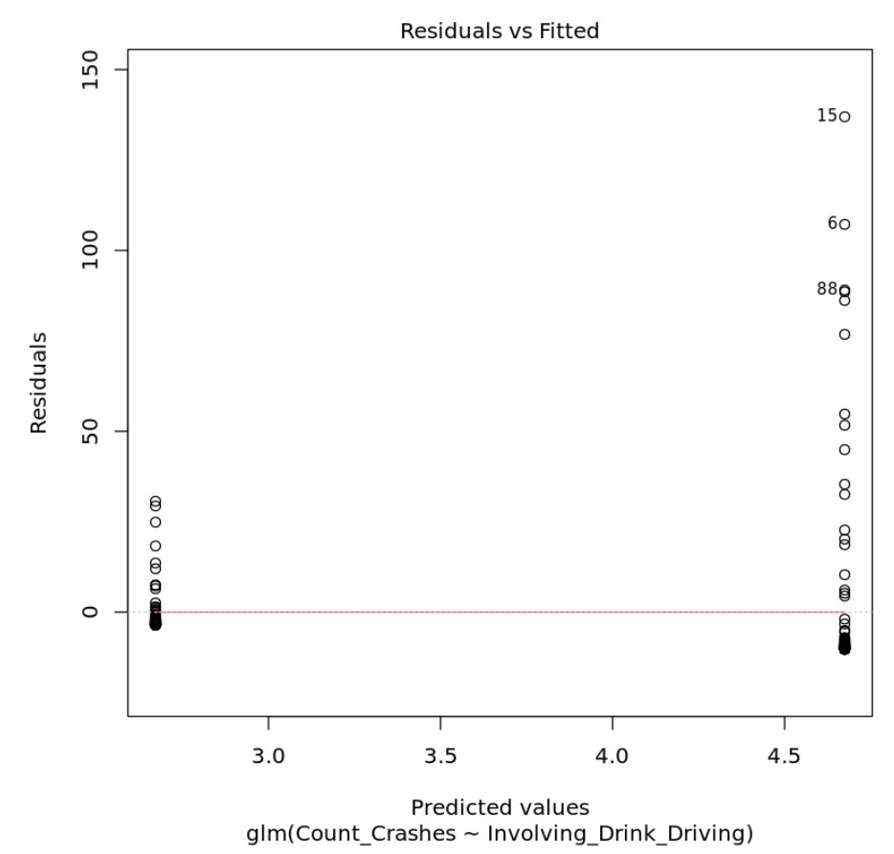
Count_crashes with involving_drink_driving

Slide 4
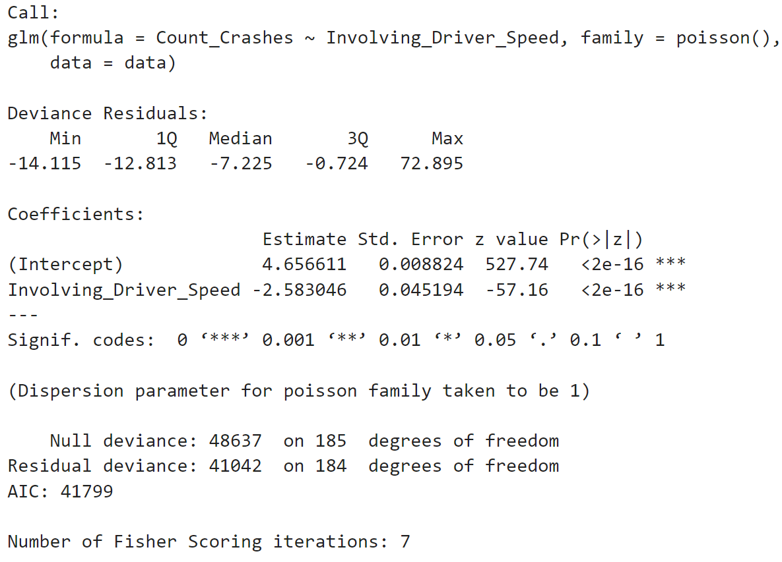
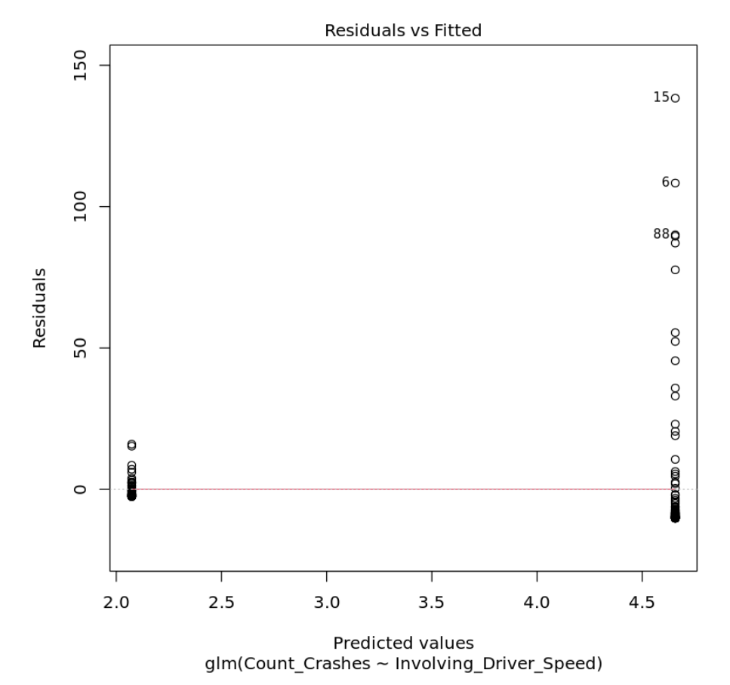
Count_crashes with involving_driver_speed

Slide 5
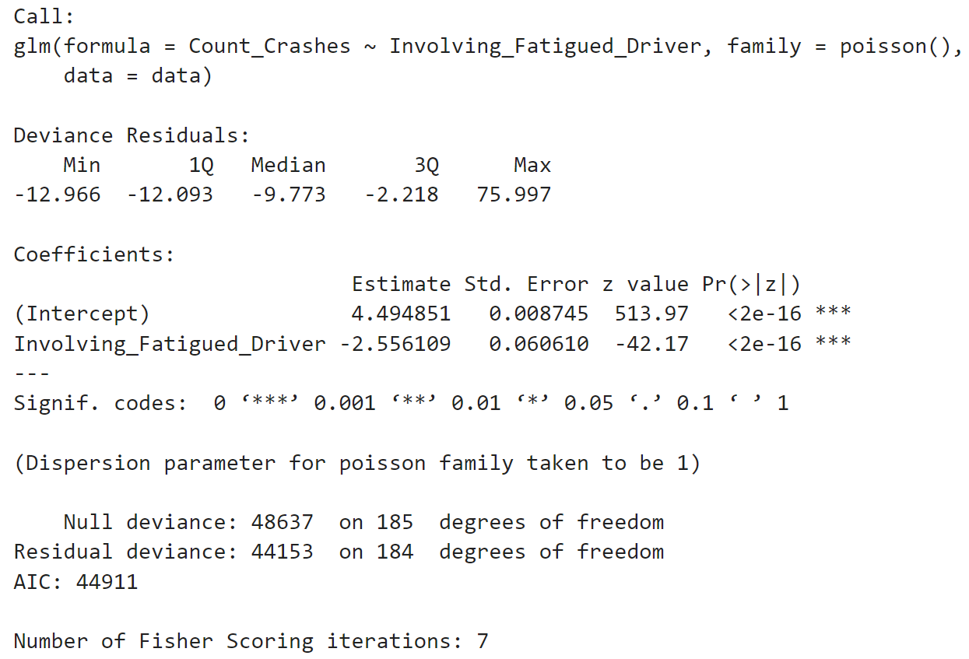
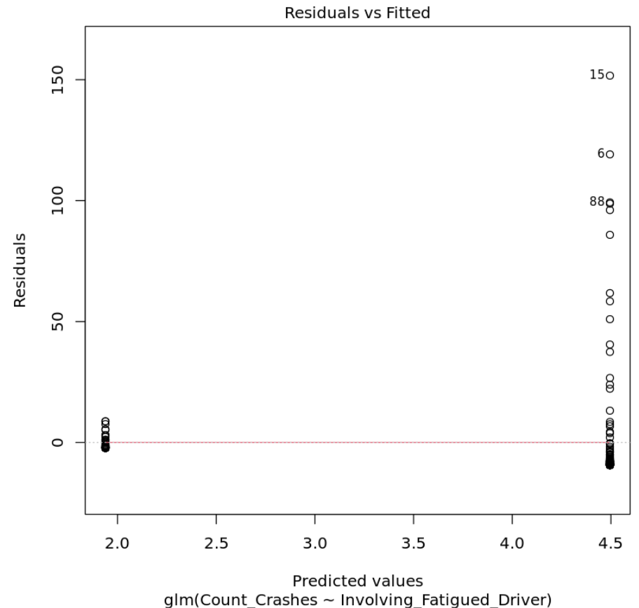
Count_crashes with involving_fatigued_driver

Slide 6
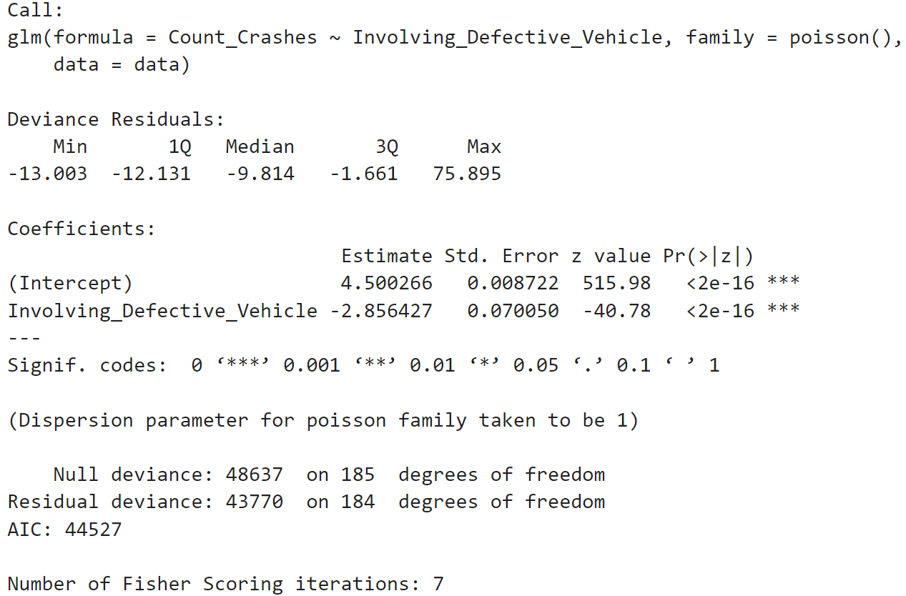
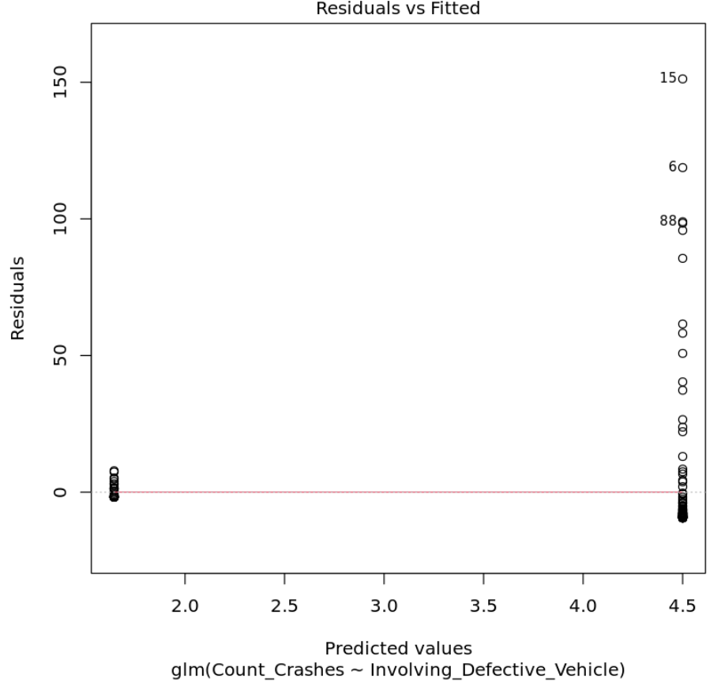
Count_crashes with involving_defective_vehicle

Slide 7
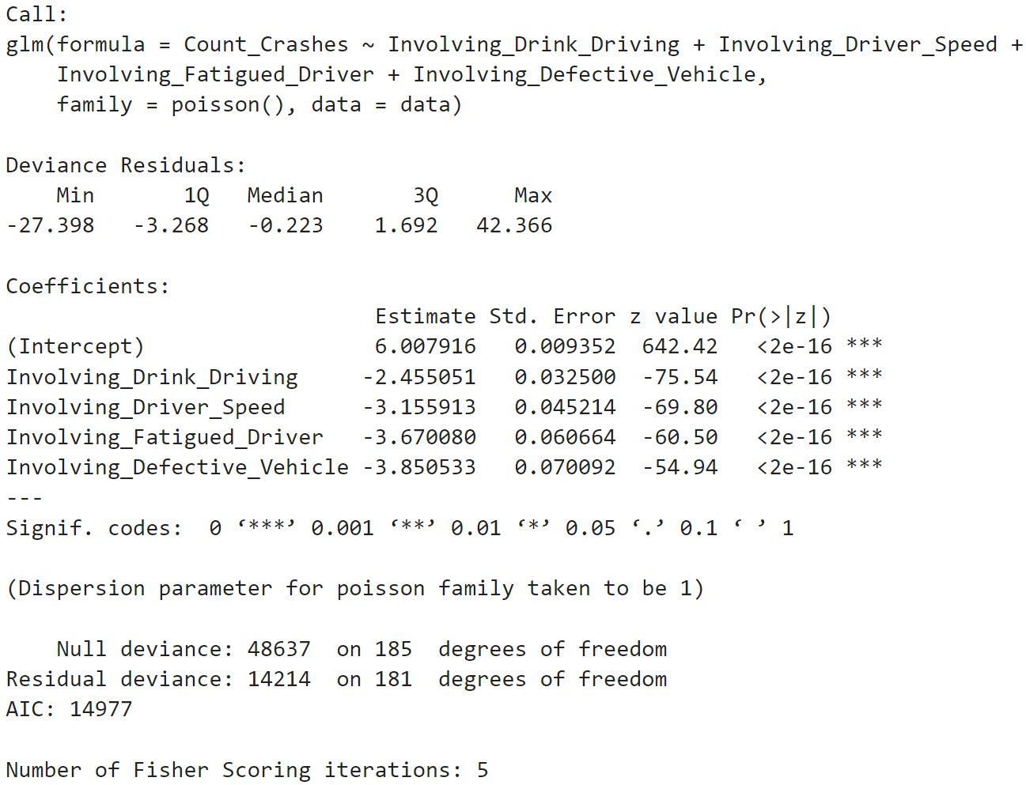
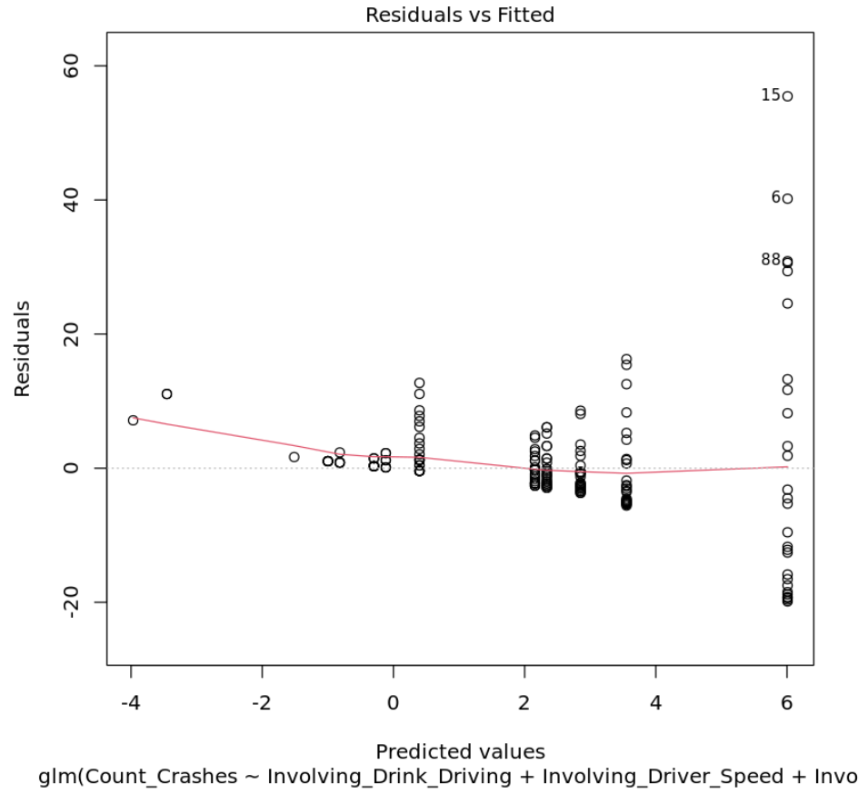
Count_crashes with
Involving_Drink_Driving | Involving_Driver_Speed | Involving_Fatigued_Driver | Involving_Defective_Vehicle

Slide 8
We used a Poisson regression model to fit the training data to investigate whether there is a linear relationship between the variables "Involving Drink Driving," "Involving Driver Speed," "Involving Fatigued Driver," "Involving Defective Vehicle," and the number of casualties (Count_All_Casualties) caused by car crashes. We then generated a model summary and fitted the model. If the red line is a straight line, it means that in this model, the relationship between the dependent variable (Crash Count_All_Casualties) and the independent variable can be described by a linear function. This also means that the effect of each unit increase in the independent variable on the dependent variable is constant, indicating a linear relationship.

Slide 9
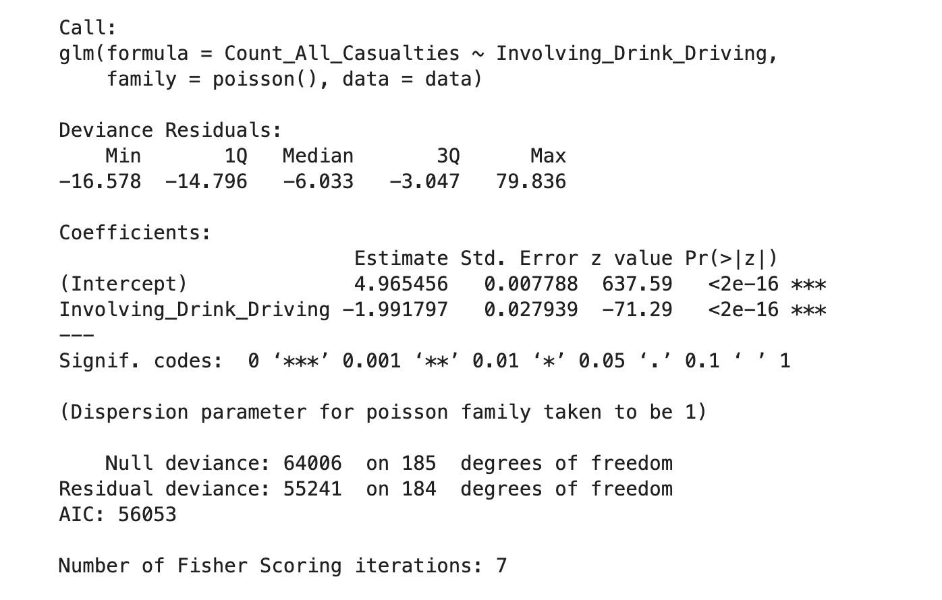
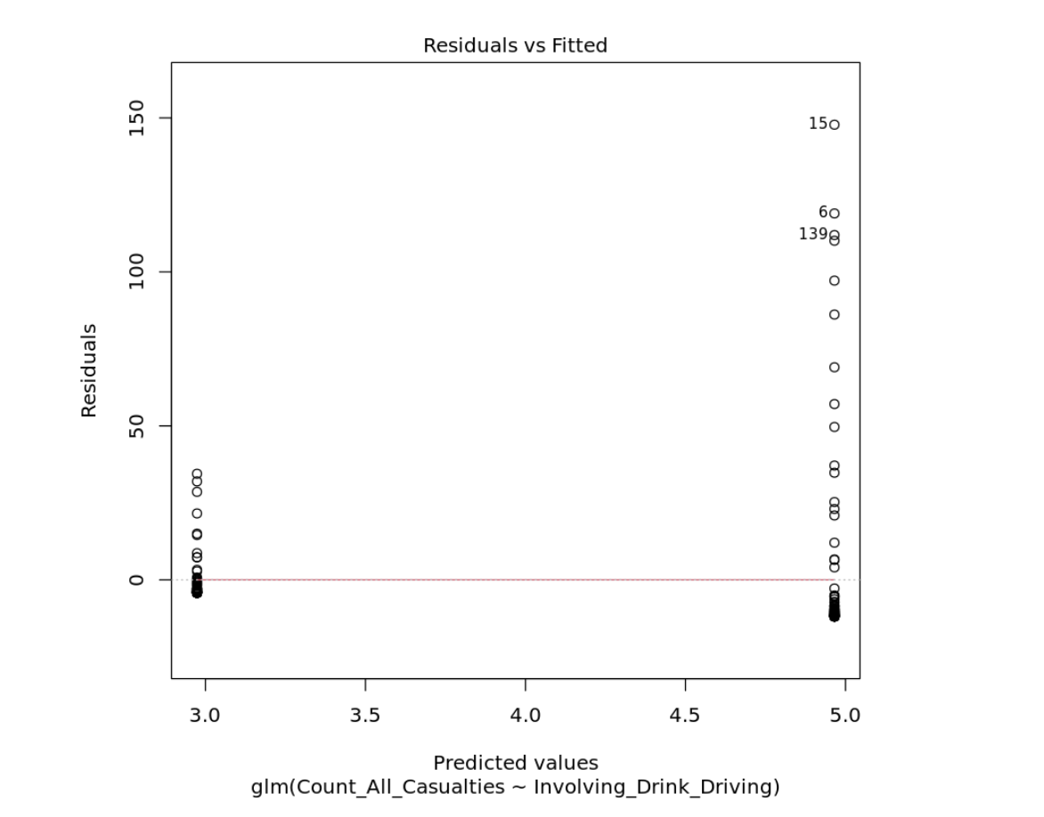
Count all casualties with involving drink driving

Slide 10
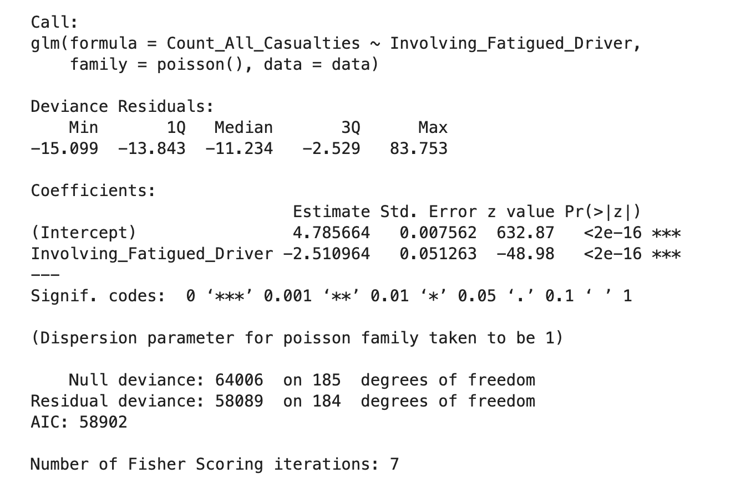
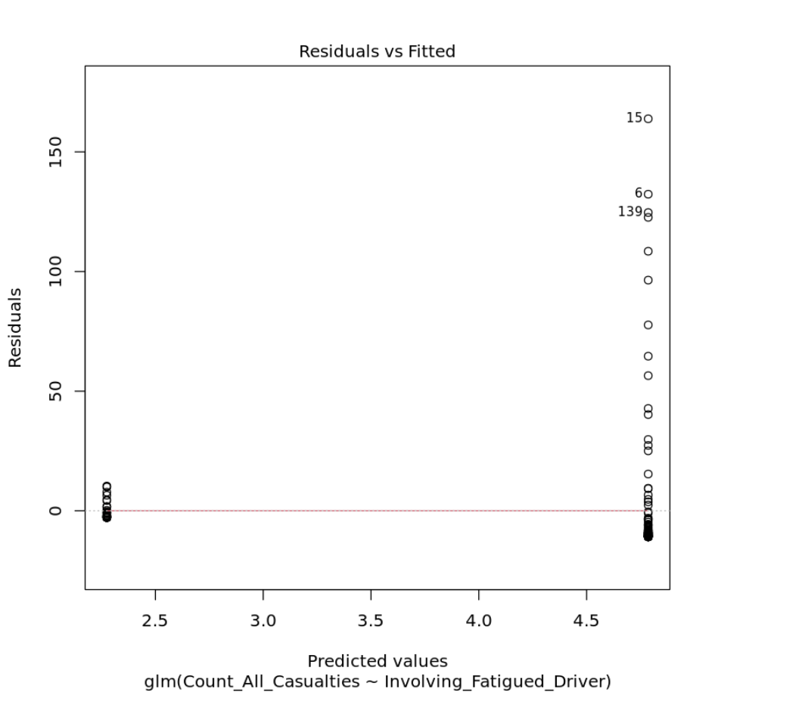
Count all casualties with involving fatigued driver

Slide 11
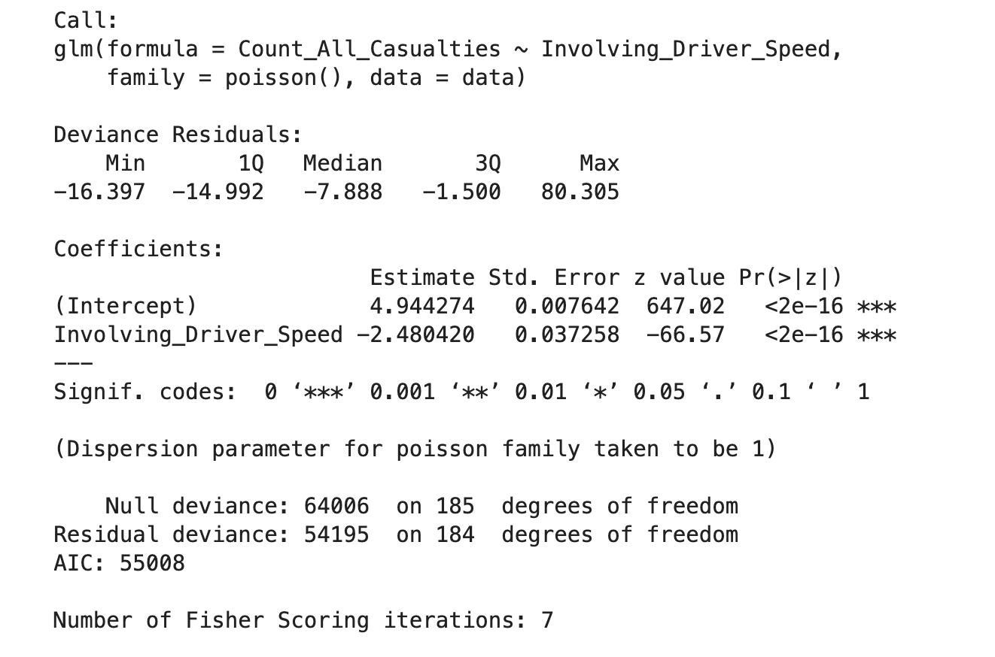
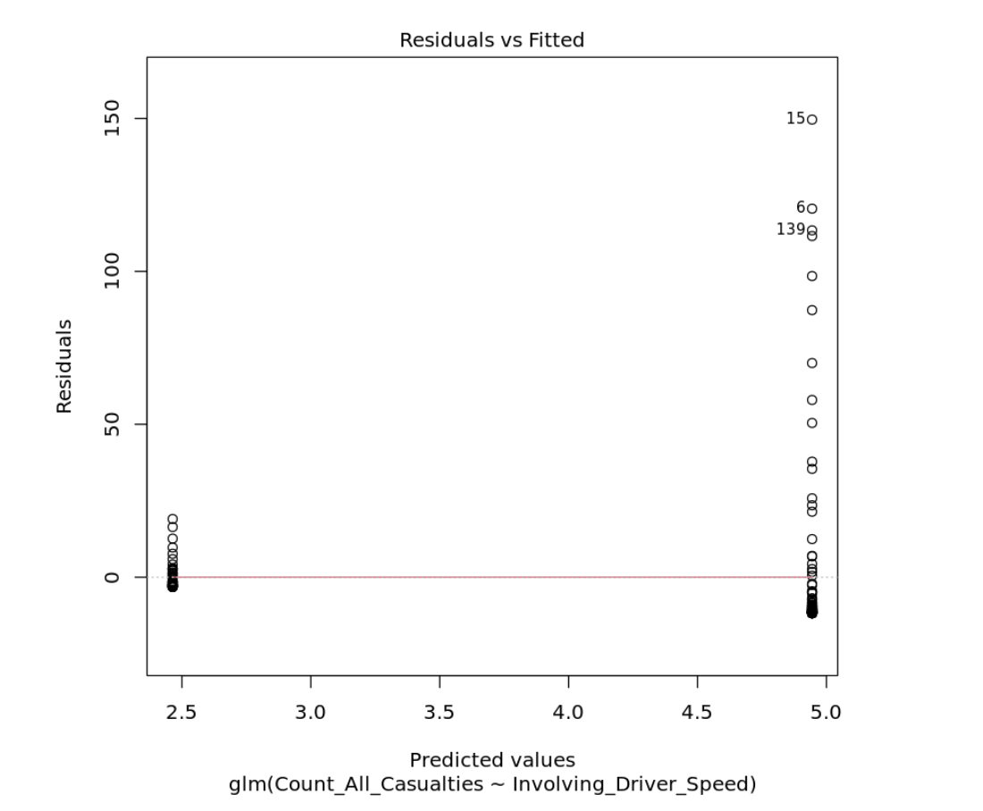
Count all casualties with involving driver speed

Slide 12
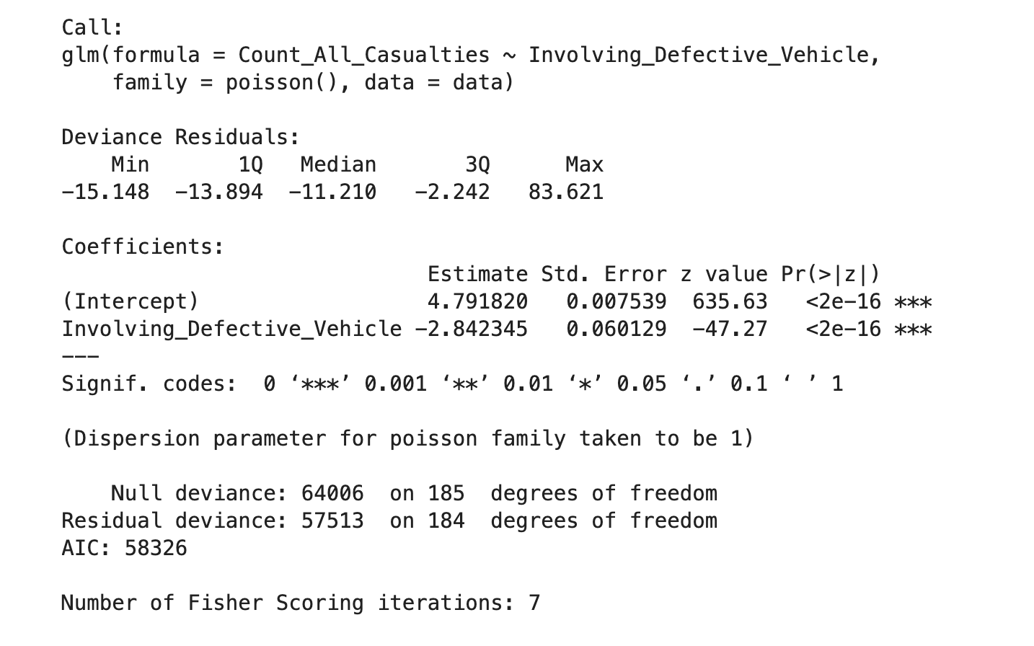
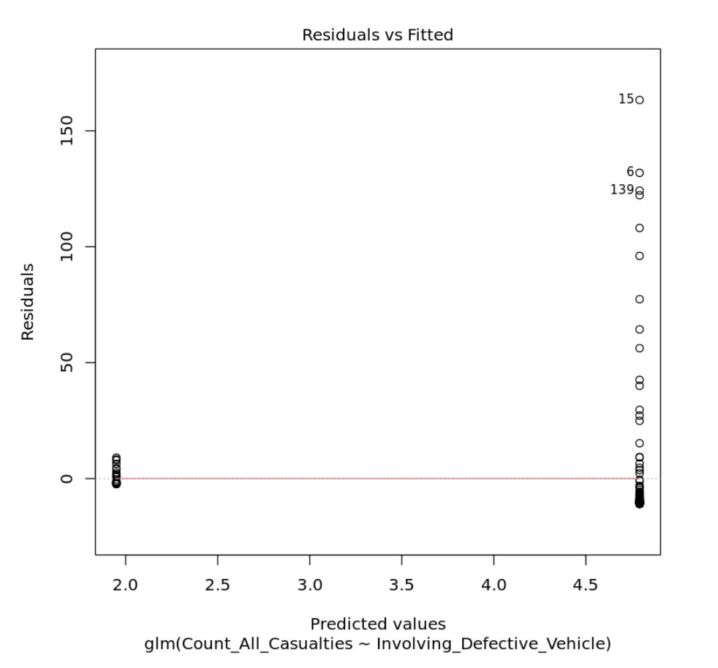
Count all casualties with involving defective vehicle

Slide 13
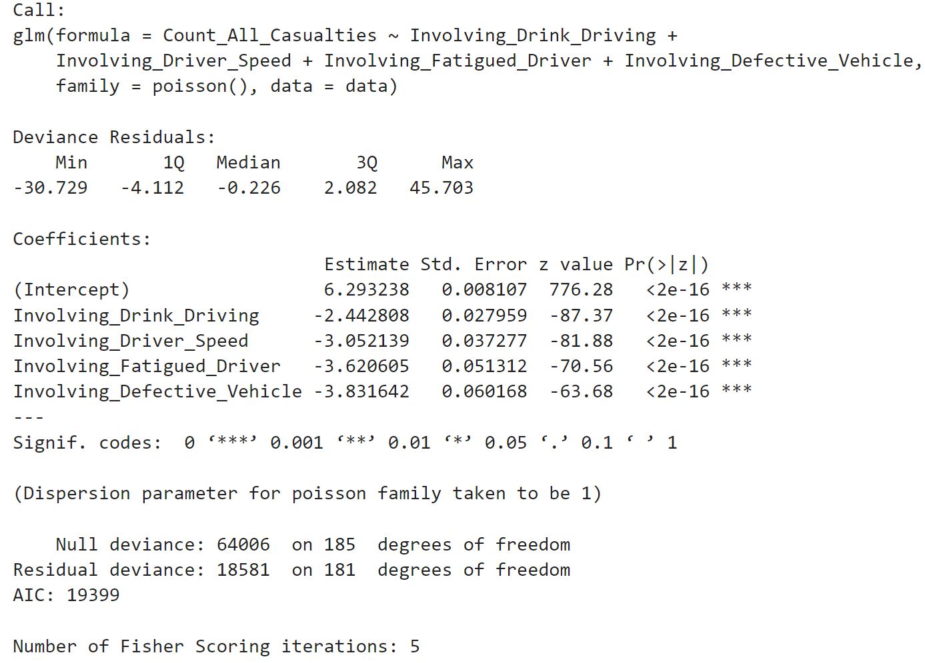
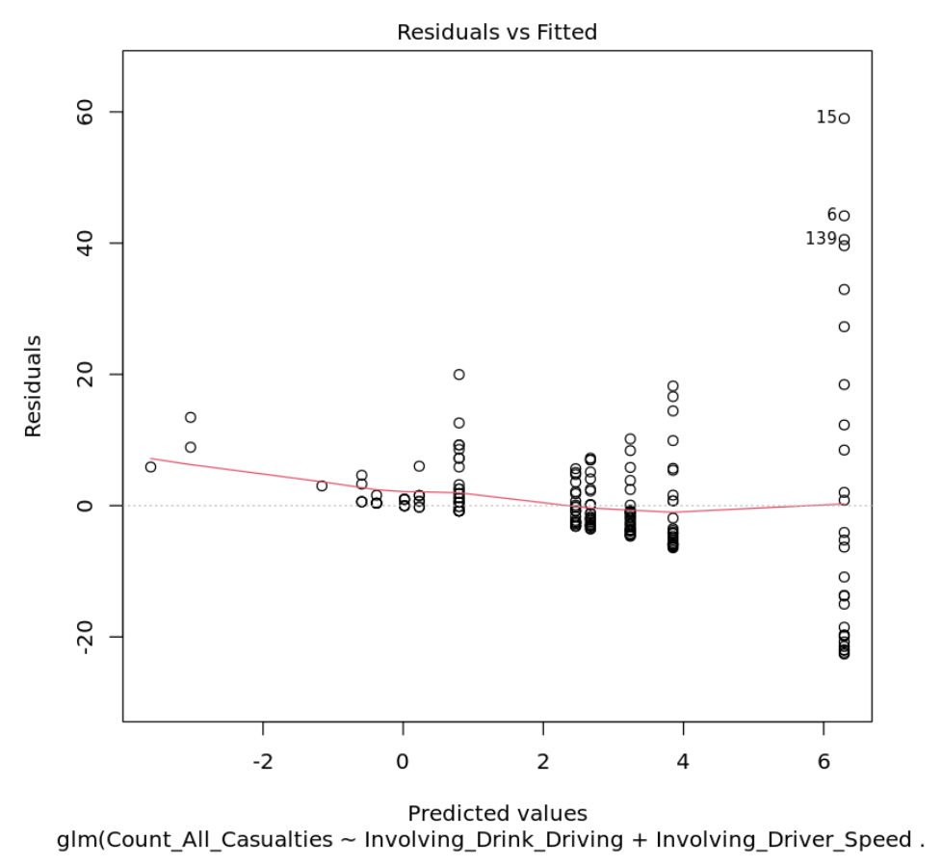
Count all casualties with involving drink driving, involving fatigued driver, involving driver speed, involving defective vehicle

